Slide 1
VALIUM

Slide 2
Contents
About us
Our Idea
Technologies
Demo

Slide 3
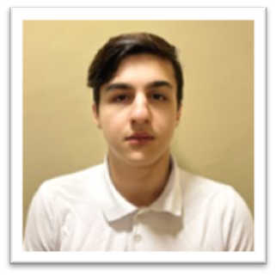
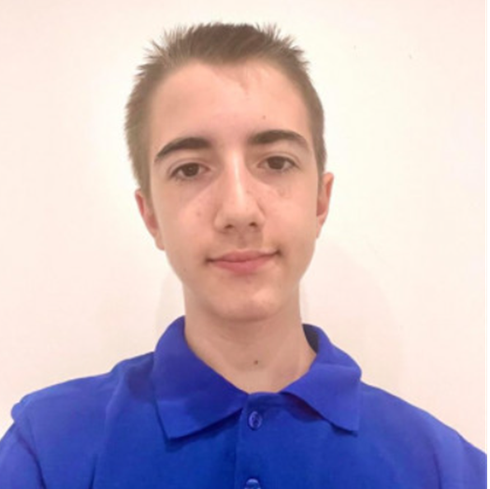
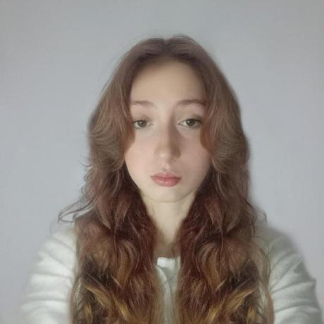
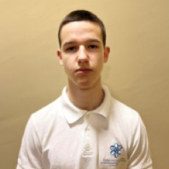
About us
Ivan Stoychev
Stelian Mikov
Backend developer
Scrum trainer
Maria Koleva
Ivelin Bozhilov
Frontend developer
Designer

Slide 4
Contents
About us
Our Idea
Technologies
Demo

Slide 5
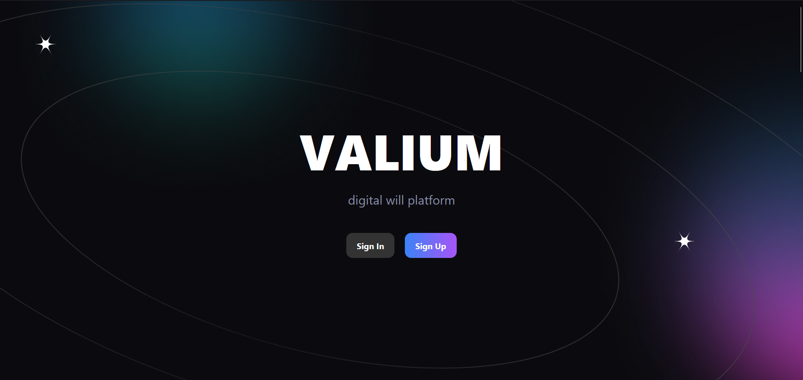
Our Idea
It is digital will site where you can bequeath your digital assets to your loved ones and ensure your legacy.

Slide 6
Contents
About us
Our Idea
Technologies
Demo

Slide 7













Technologies

Slide 8
Contents
About us
Our Idea
Technologies
demo

Slide 9
Now let’s check out a quick demo

